Slide 1


Corona virus Analysis Using SQL

Slide 2
About The Presentation
The CORONA VIRUS pandemic has had a significant impact on public health.
created an urgent need for data-driven insights to understand the spread of the virus.
As a Data Analyst, I am working on tasked with analyzing a CORONA VIRUS dataset to derive meaningful insights and findings Using MySQL workbench.

Slide 3
Description of each column in our dataset:
Province: Geographic subdivision within a country/region.
Country/Region: Geographic entity where data is recorded.
Latitude: North-south position on Earth's surface.
Longitude: East-west position on Earth's surface.
Date: Recorded date of CORONA VIRUS data.
Confirmed: Number of diagnosed CORONA VIRUS cases.
Deaths: Number of CORONA VIRUS related deaths.
Recovered: Number of recovered CORONA VIRUS cases.

Slide 4
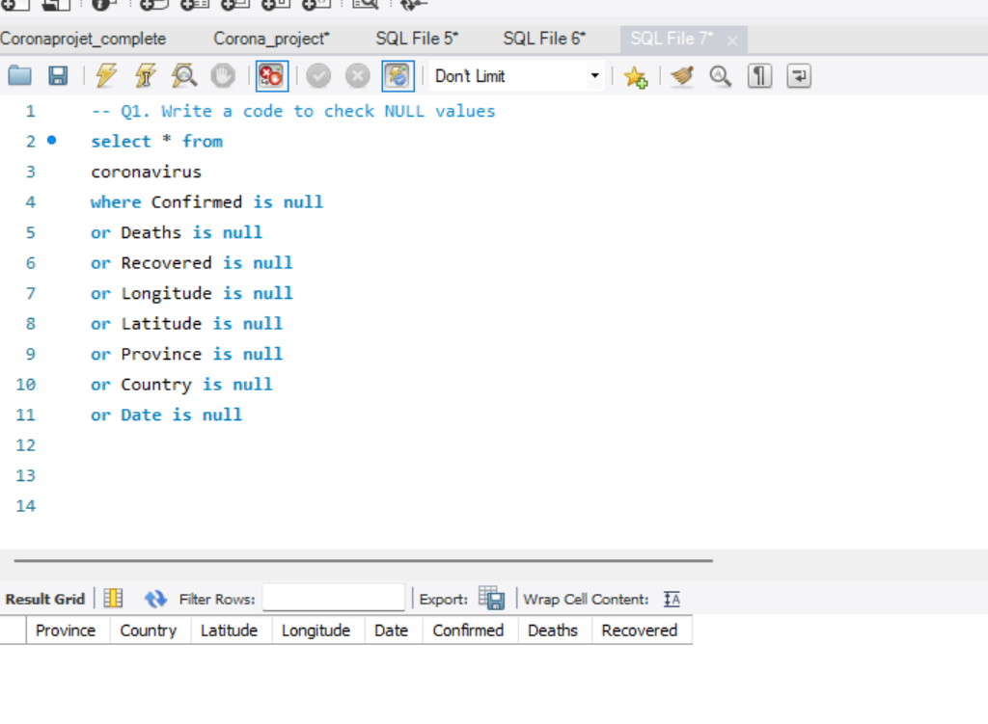
-- Q1. Write a code to check NULL values

Slide 5
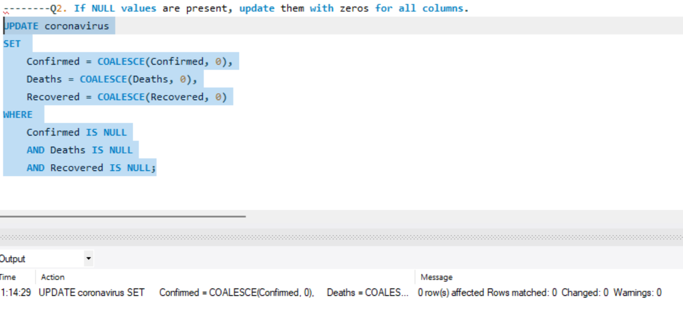
--Q2. If NULL values are present, update them with zeros for all columns.

Slide 6
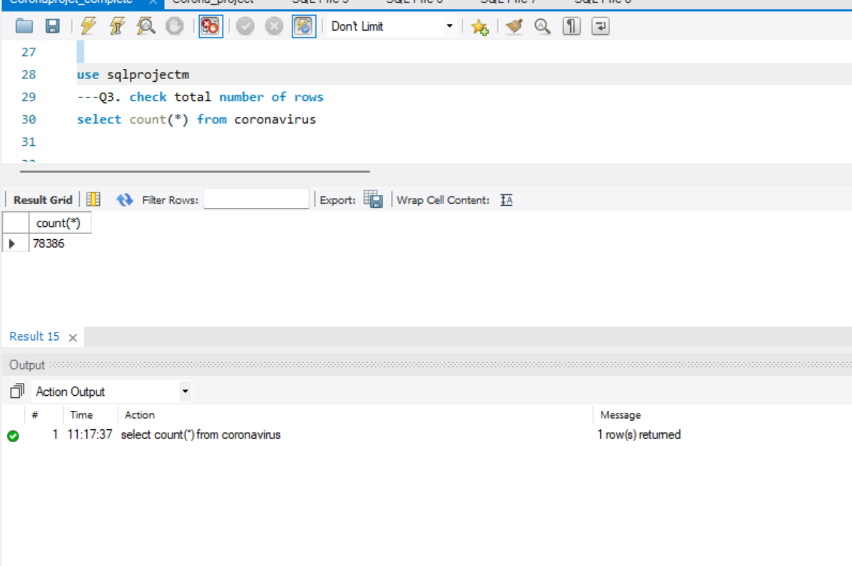
-- Q3. check total number of rows

Slide 7
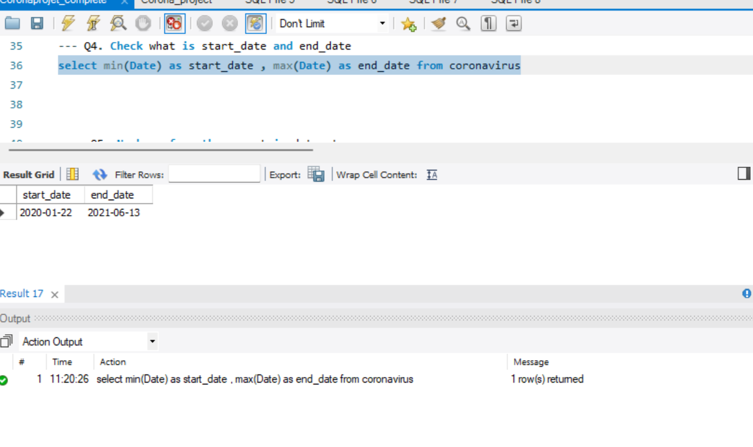
-- Q4. Check what is startdate and enddate

Slide 8
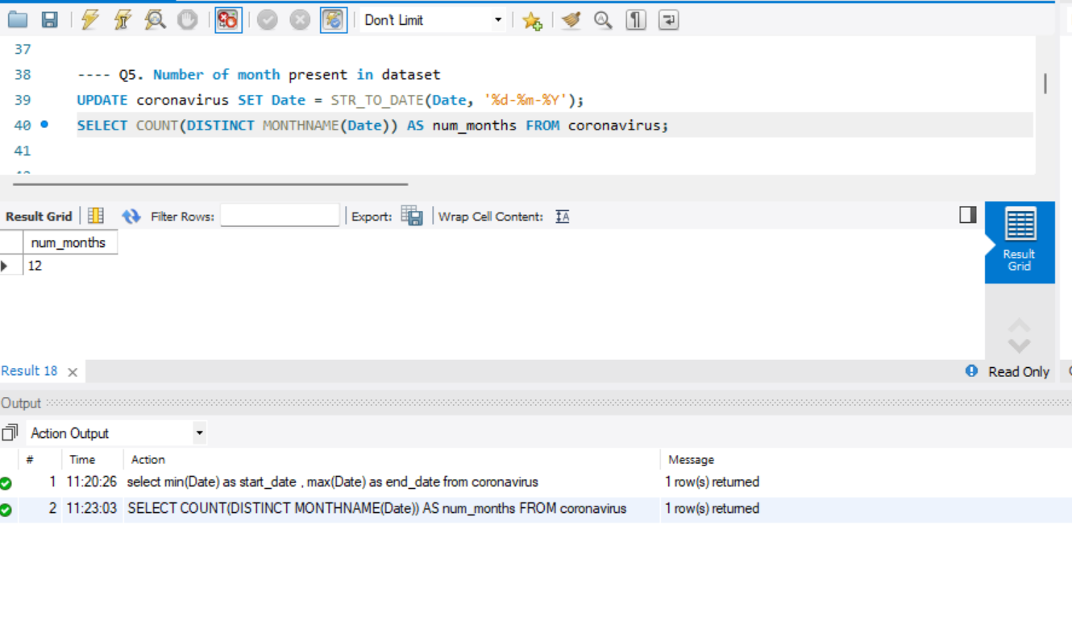
-- Q5. Number of month present in dataset

Slide 9
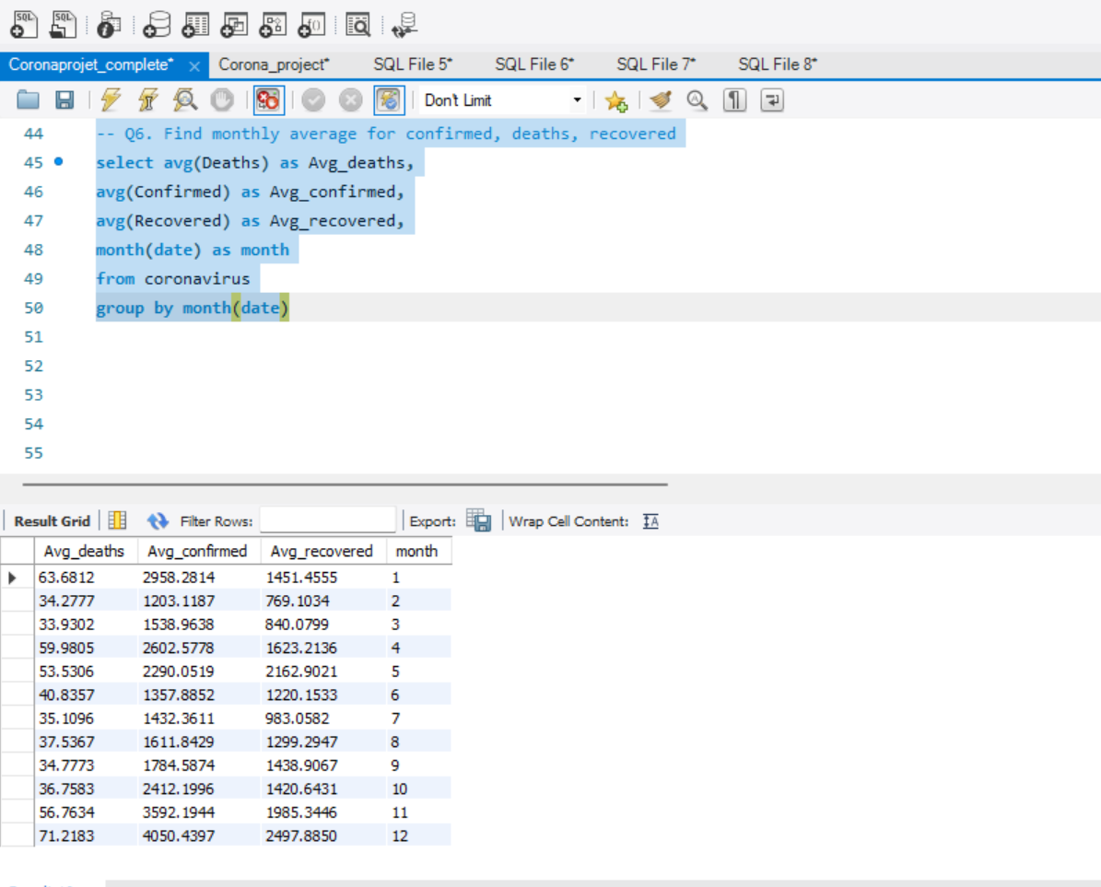
- Q6. Find monthly average for confirmed, deaths, recovered

Slide 10
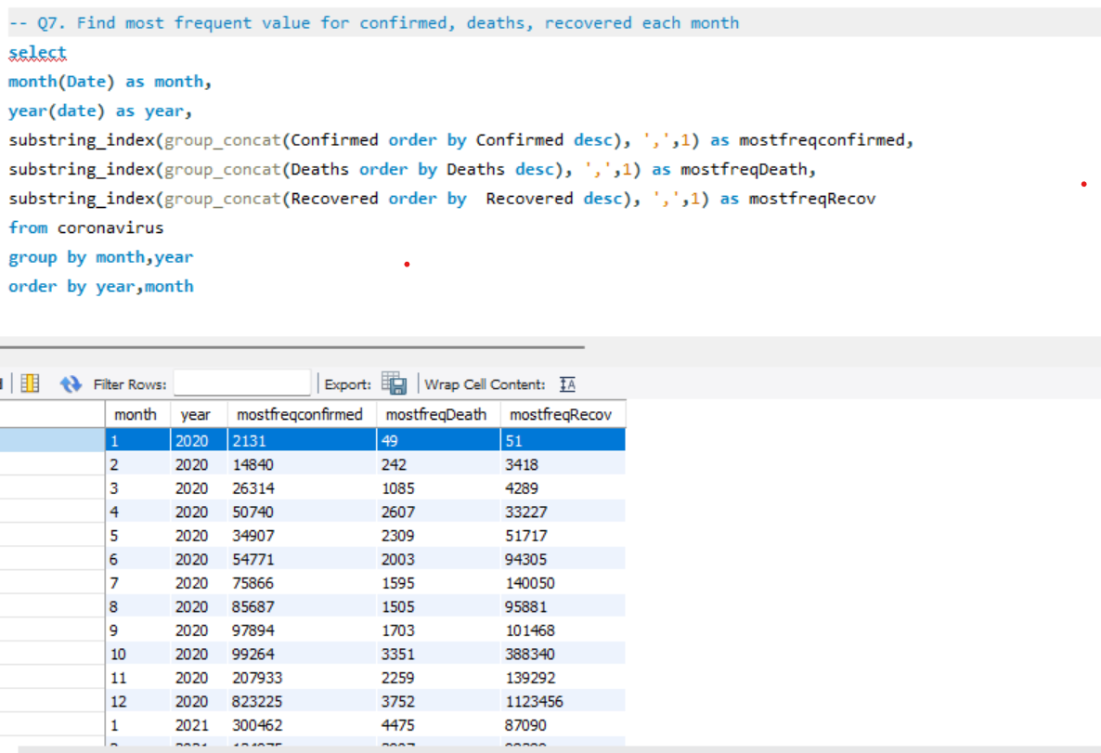
Q7. Find most frequent value for
confirmed, deaths, recovered each month

Slide 11
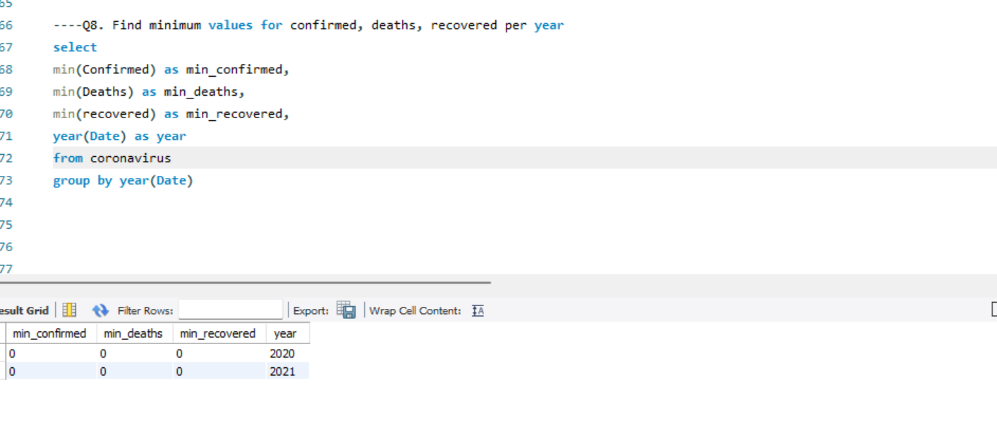
Q8. Find minimum values for confirmed, deaths,
recovered per year

Slide 12
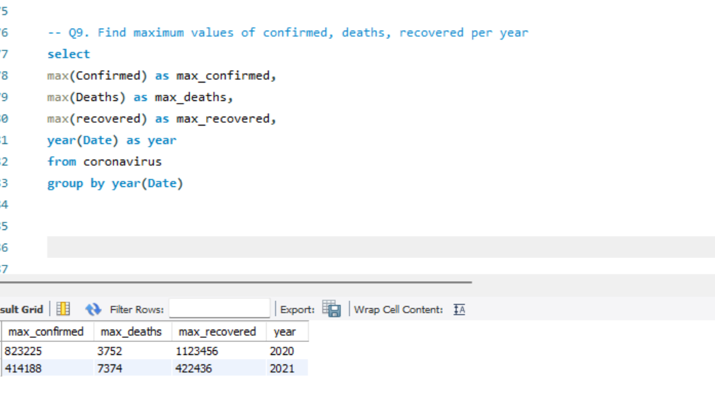
Q9. Find maximum values of confirmed, deaths,
recovered per year

Slide 13
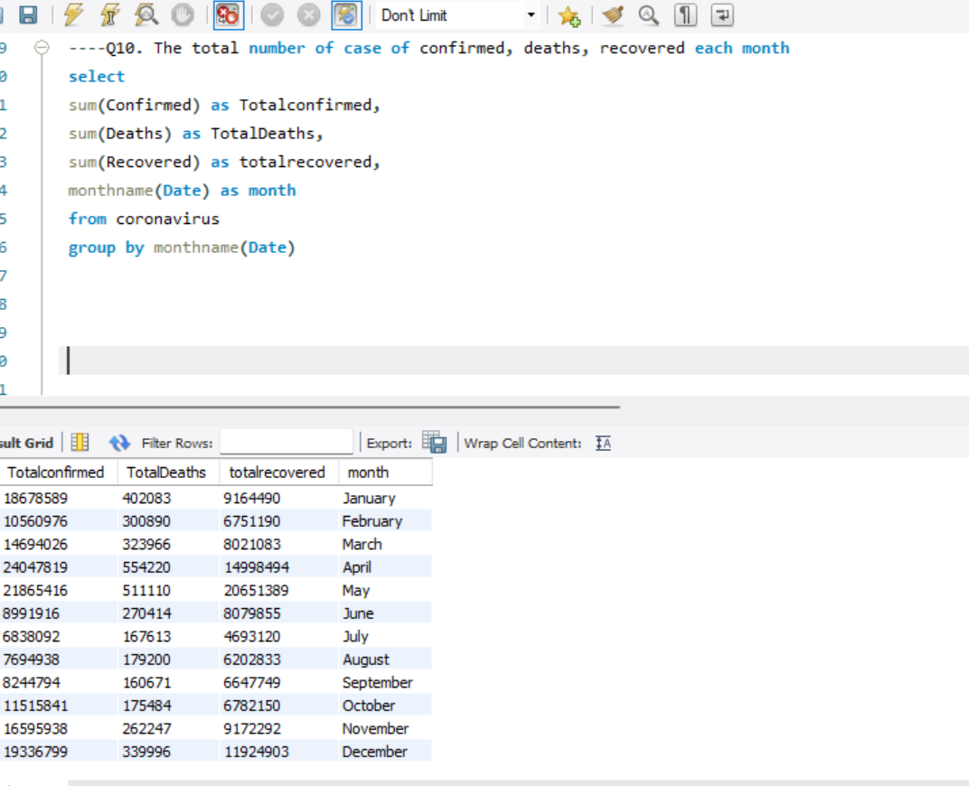
----Q10. The total number of case of confirmed, deaths, recovered each month

Slide 14
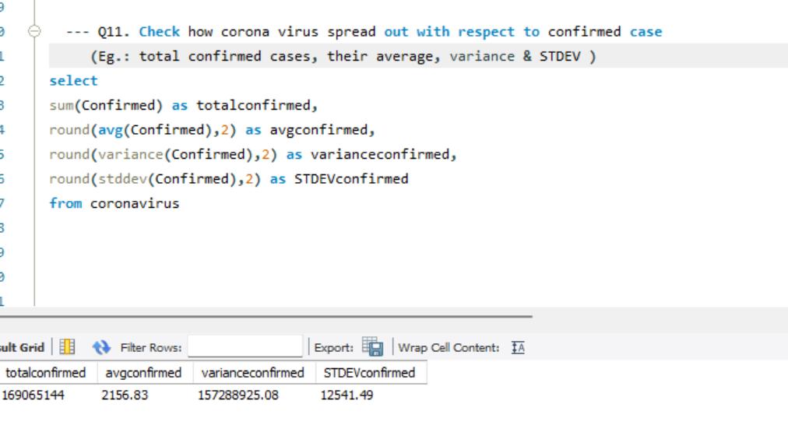
Q11. Check how corona virus spread out with respect to confirmed case
-- (Eg.: total confirmed cases, their average, variance & STDEV )

Slide 15
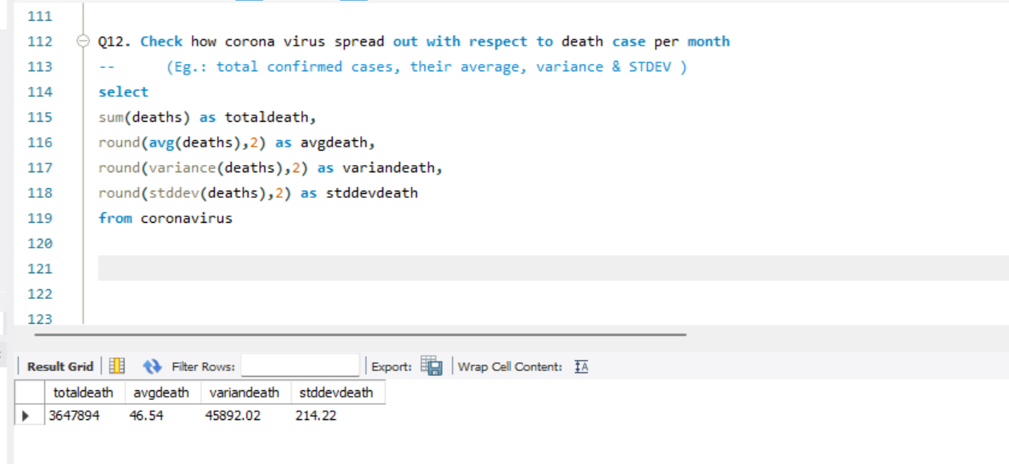
Q12. Check how corona virus spread out with respect to death case per month
(Eg.: total confirmed cases, their average, variance & STDEV

Slide 16
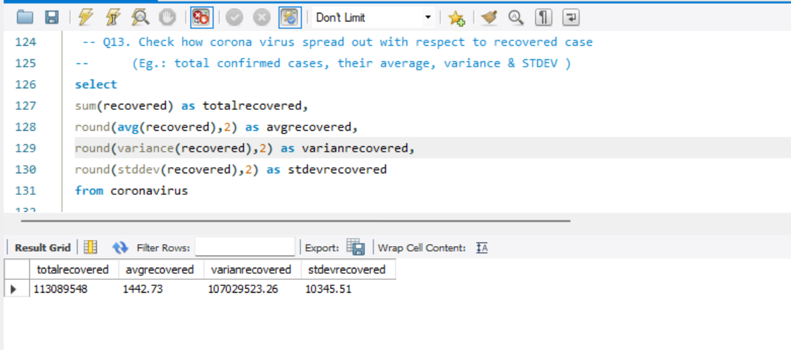
Q13. Check how corona virus spread out with respect to recovered case
(Eg.: total confirmed cases,their average, variance & STDEV )

Slide 17
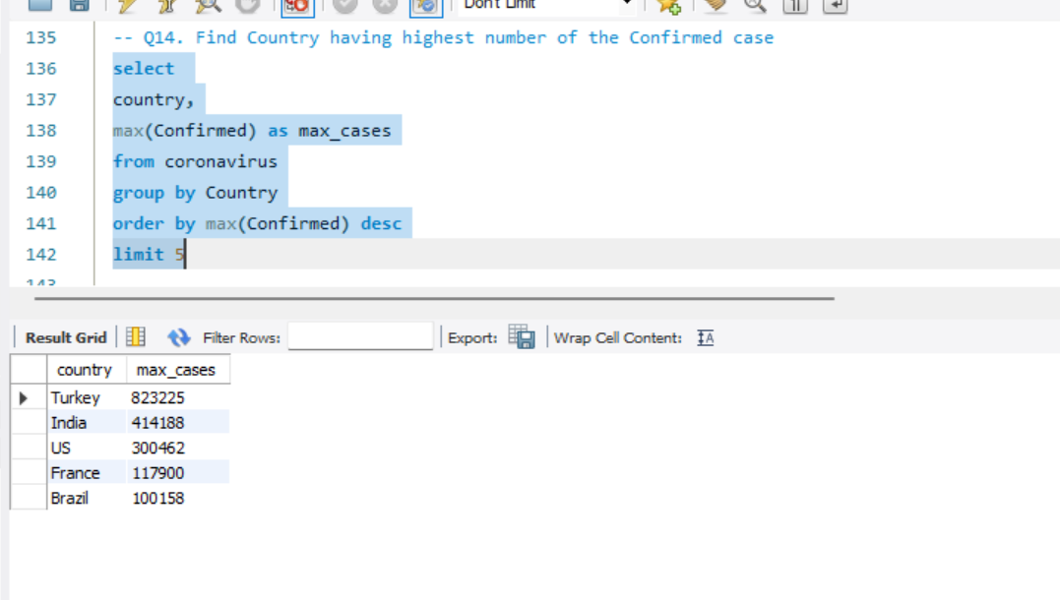
-- Q14. Find Country having highest number of the Confirmed case

Slide 18
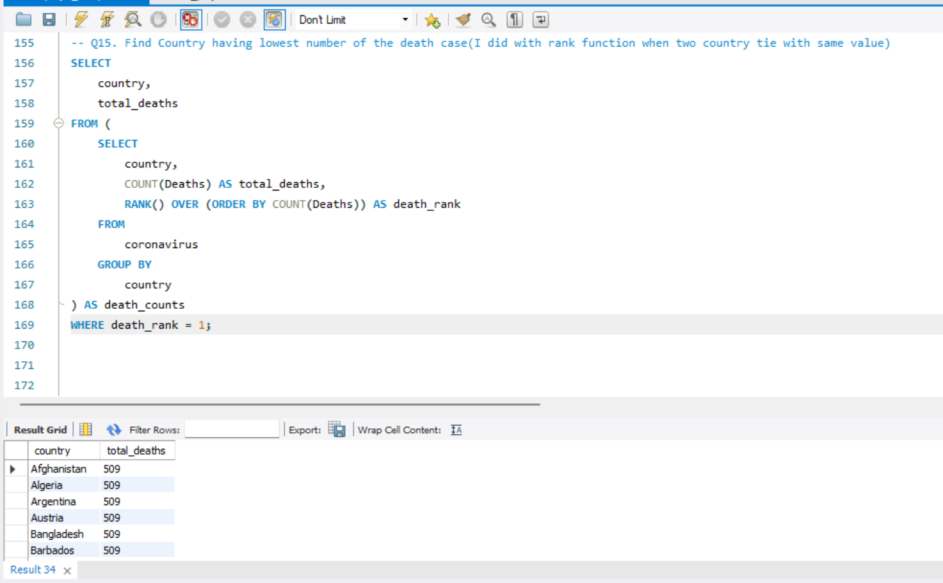
-- Q15. Find Country having lowest number of the death case

Slide 19
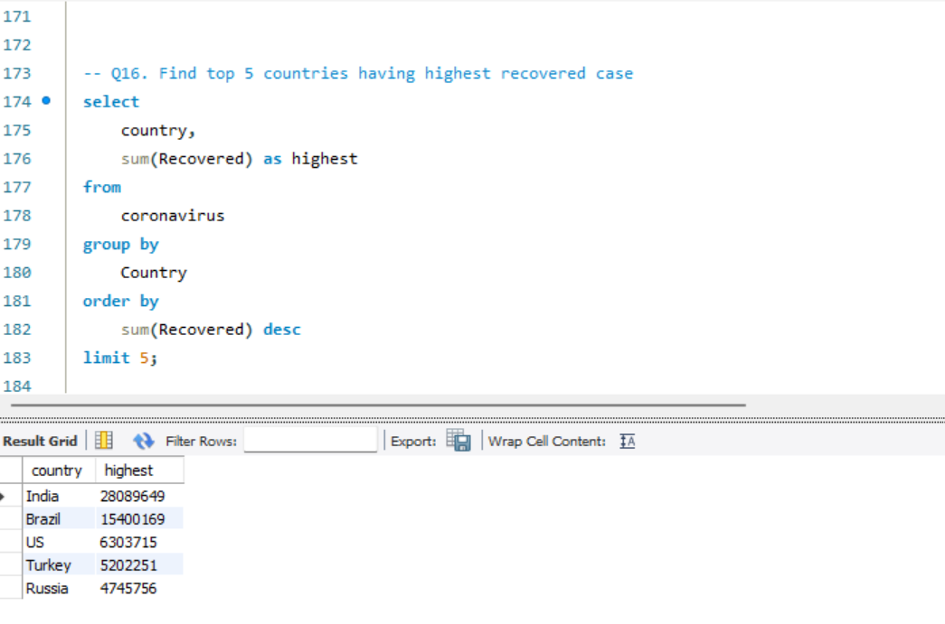
-- Q16. Find top 5 countries having highest recovered case

Slide 20
Thank you

